Slide 1
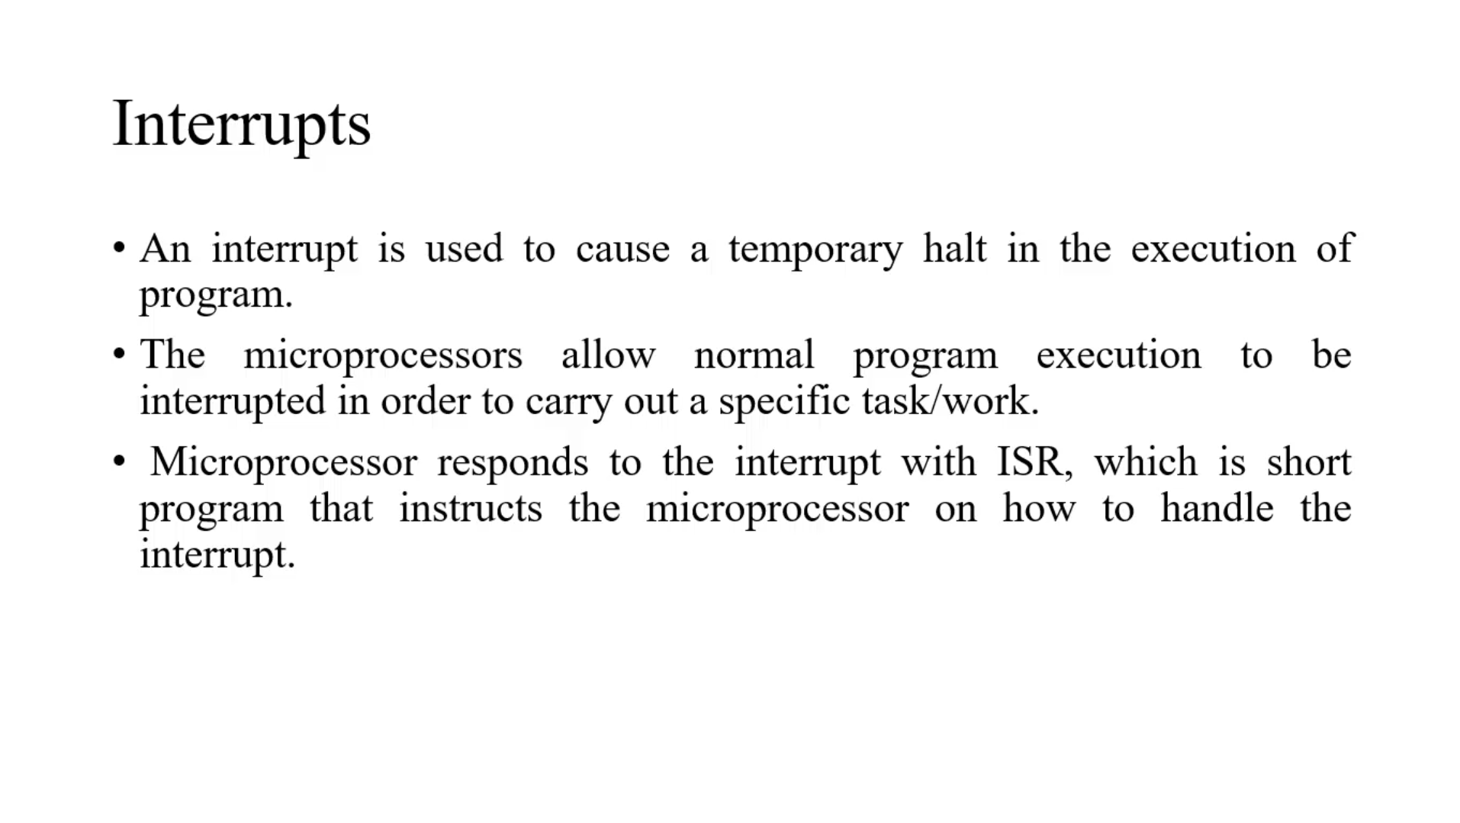

Slide 2
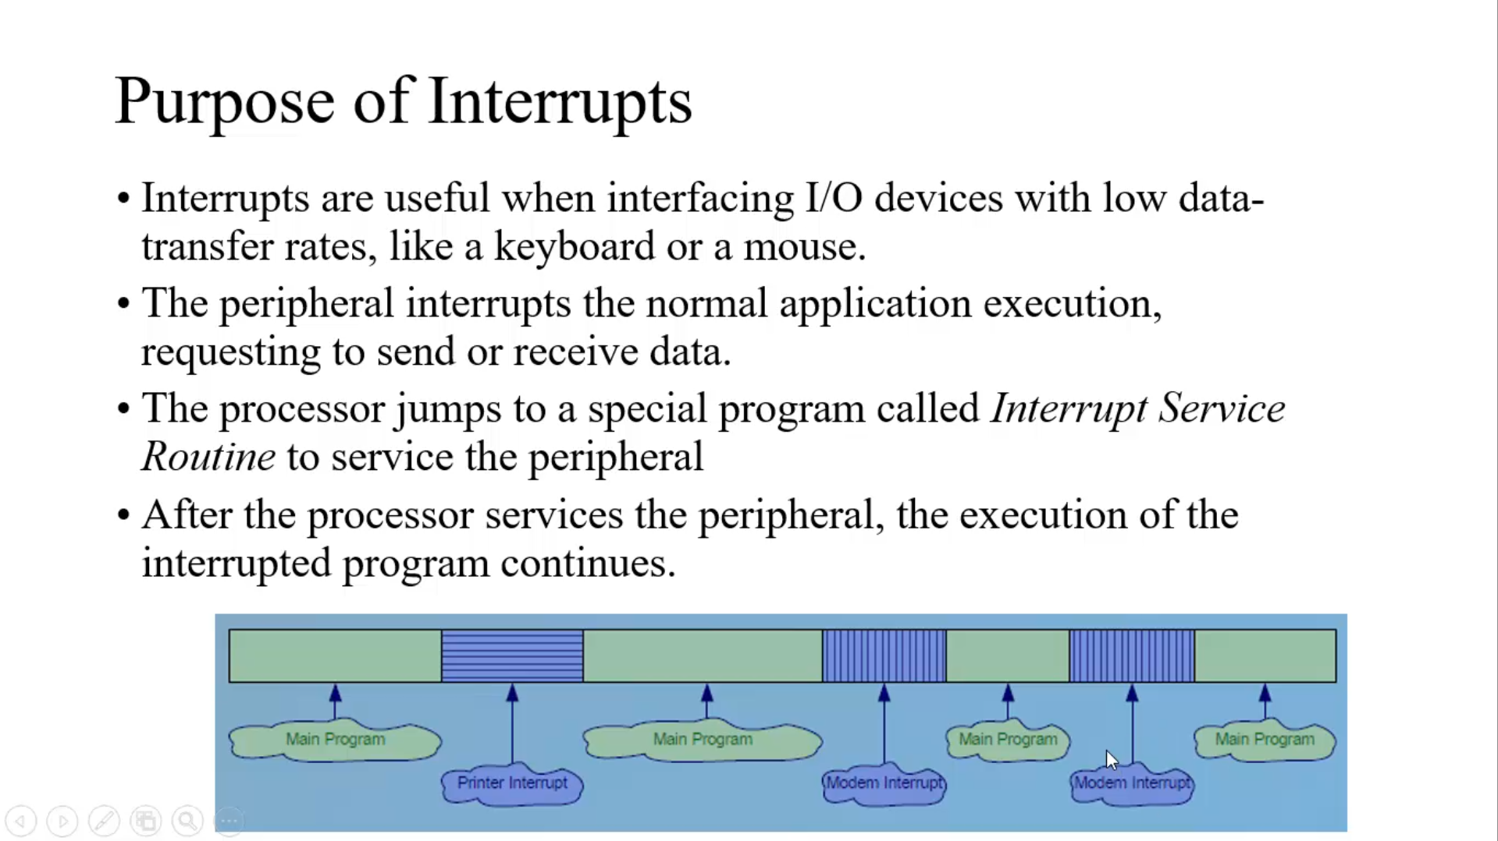

Slide 3
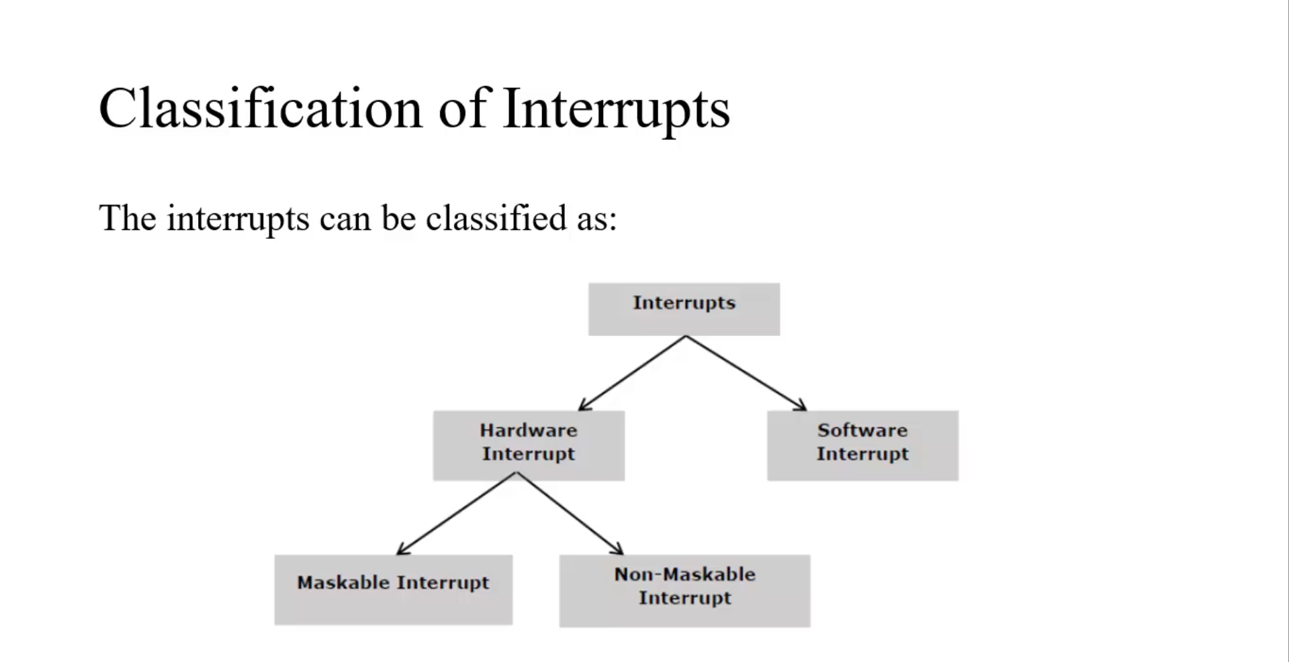
Hardware Interrupt: The Request Initiated by Hardware to the interrupt pins, There are Two hardware Interrupt Pins INTR and NMI
1. Maskable Interrupt: The Request can be rejected or accepted.
2. Non Maskable Interrupt: The Request always accepted.
Software Interrupt: The Request Initiated by software to the interrupt pins.
These are Program Instruction. 256 Types of Software Interrupts

Slide 4
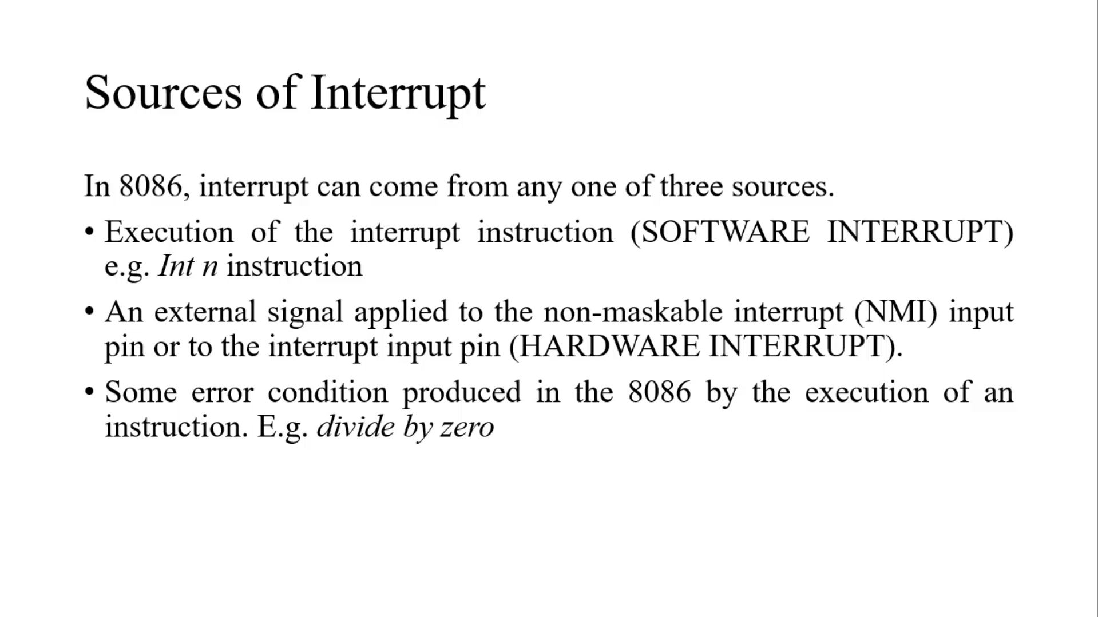

Slide 5
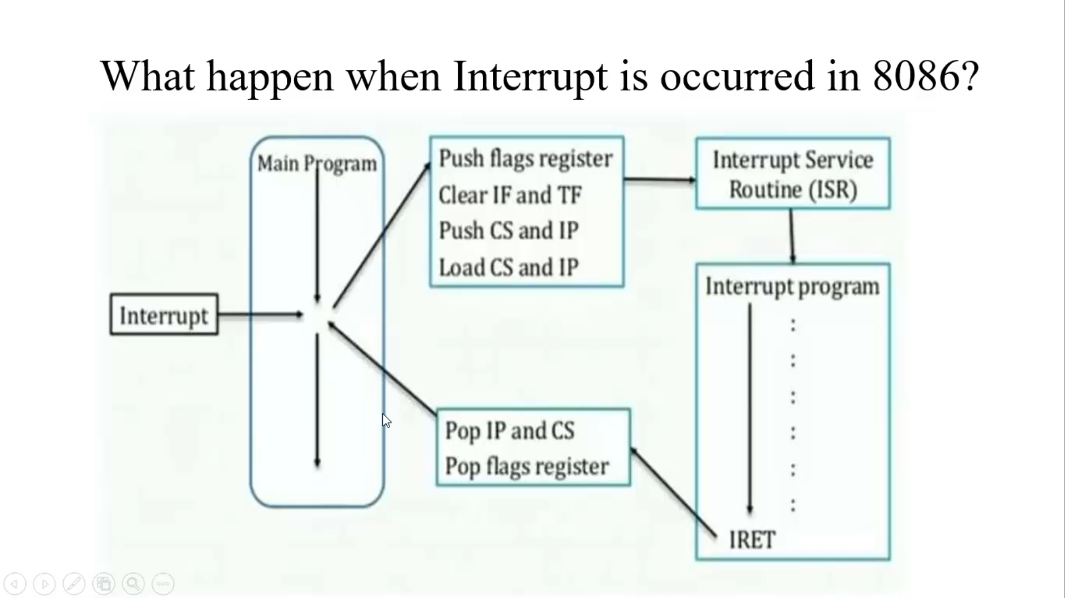

Slide 6
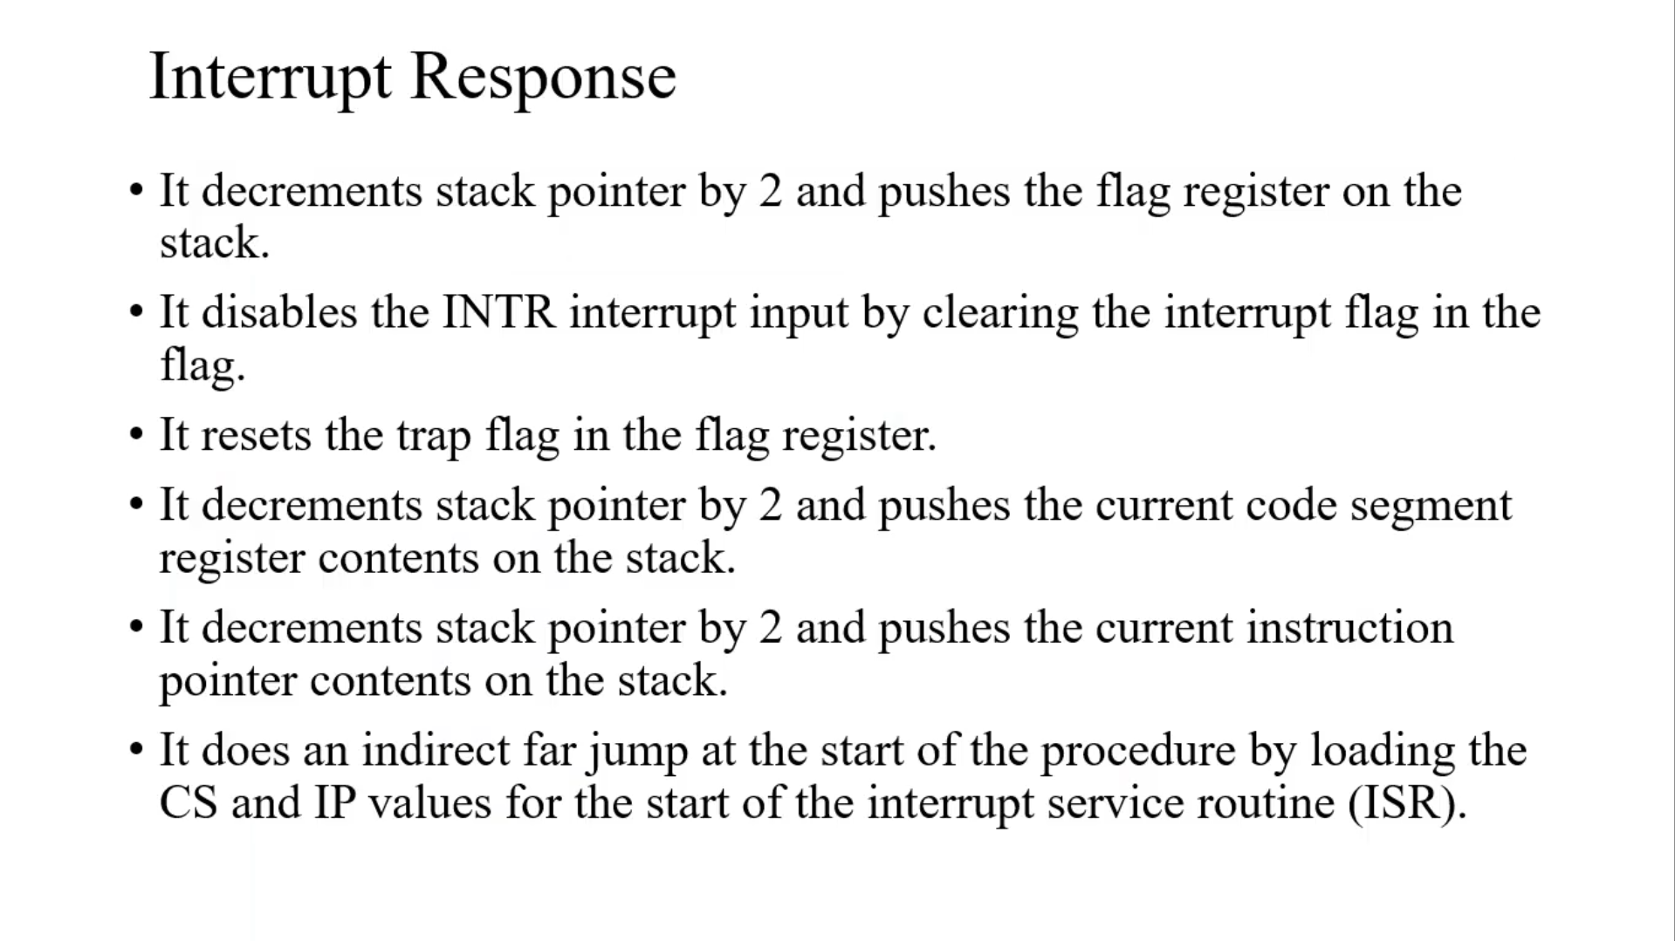

Slide 7
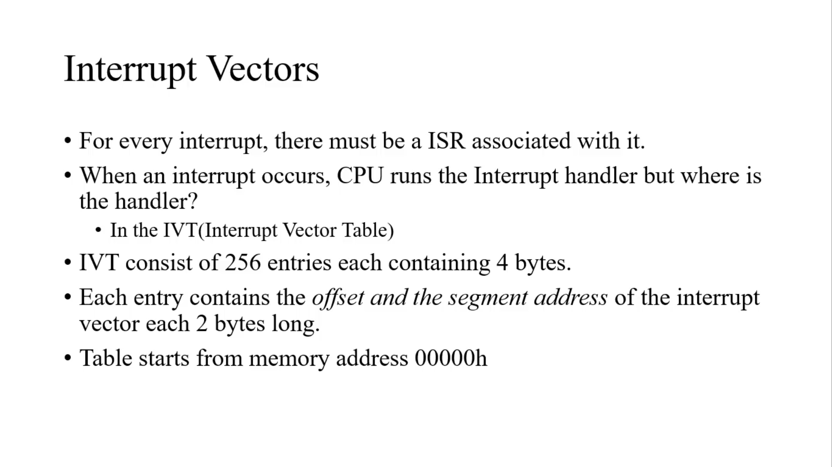

Slide 8
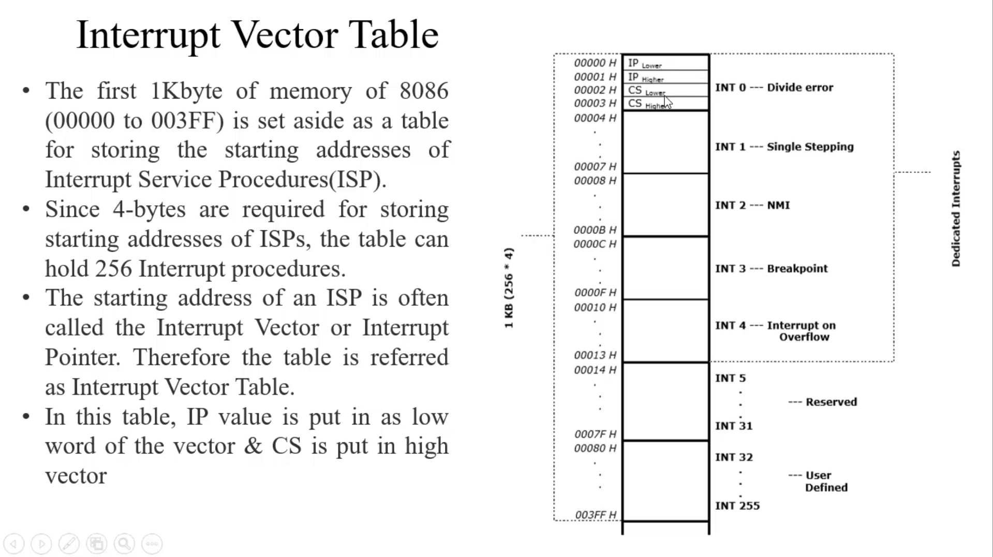

Slide 9
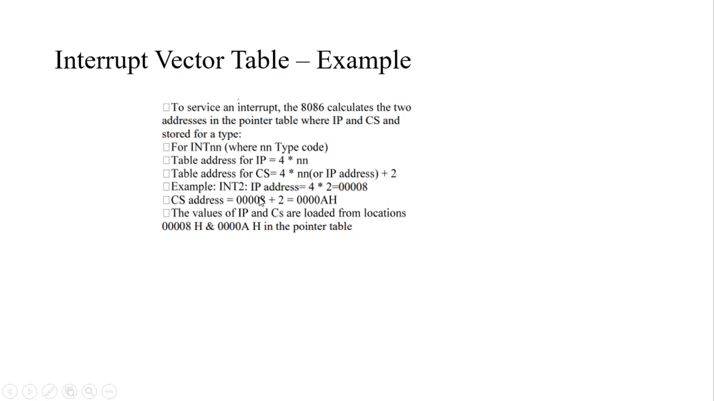

Slide 10
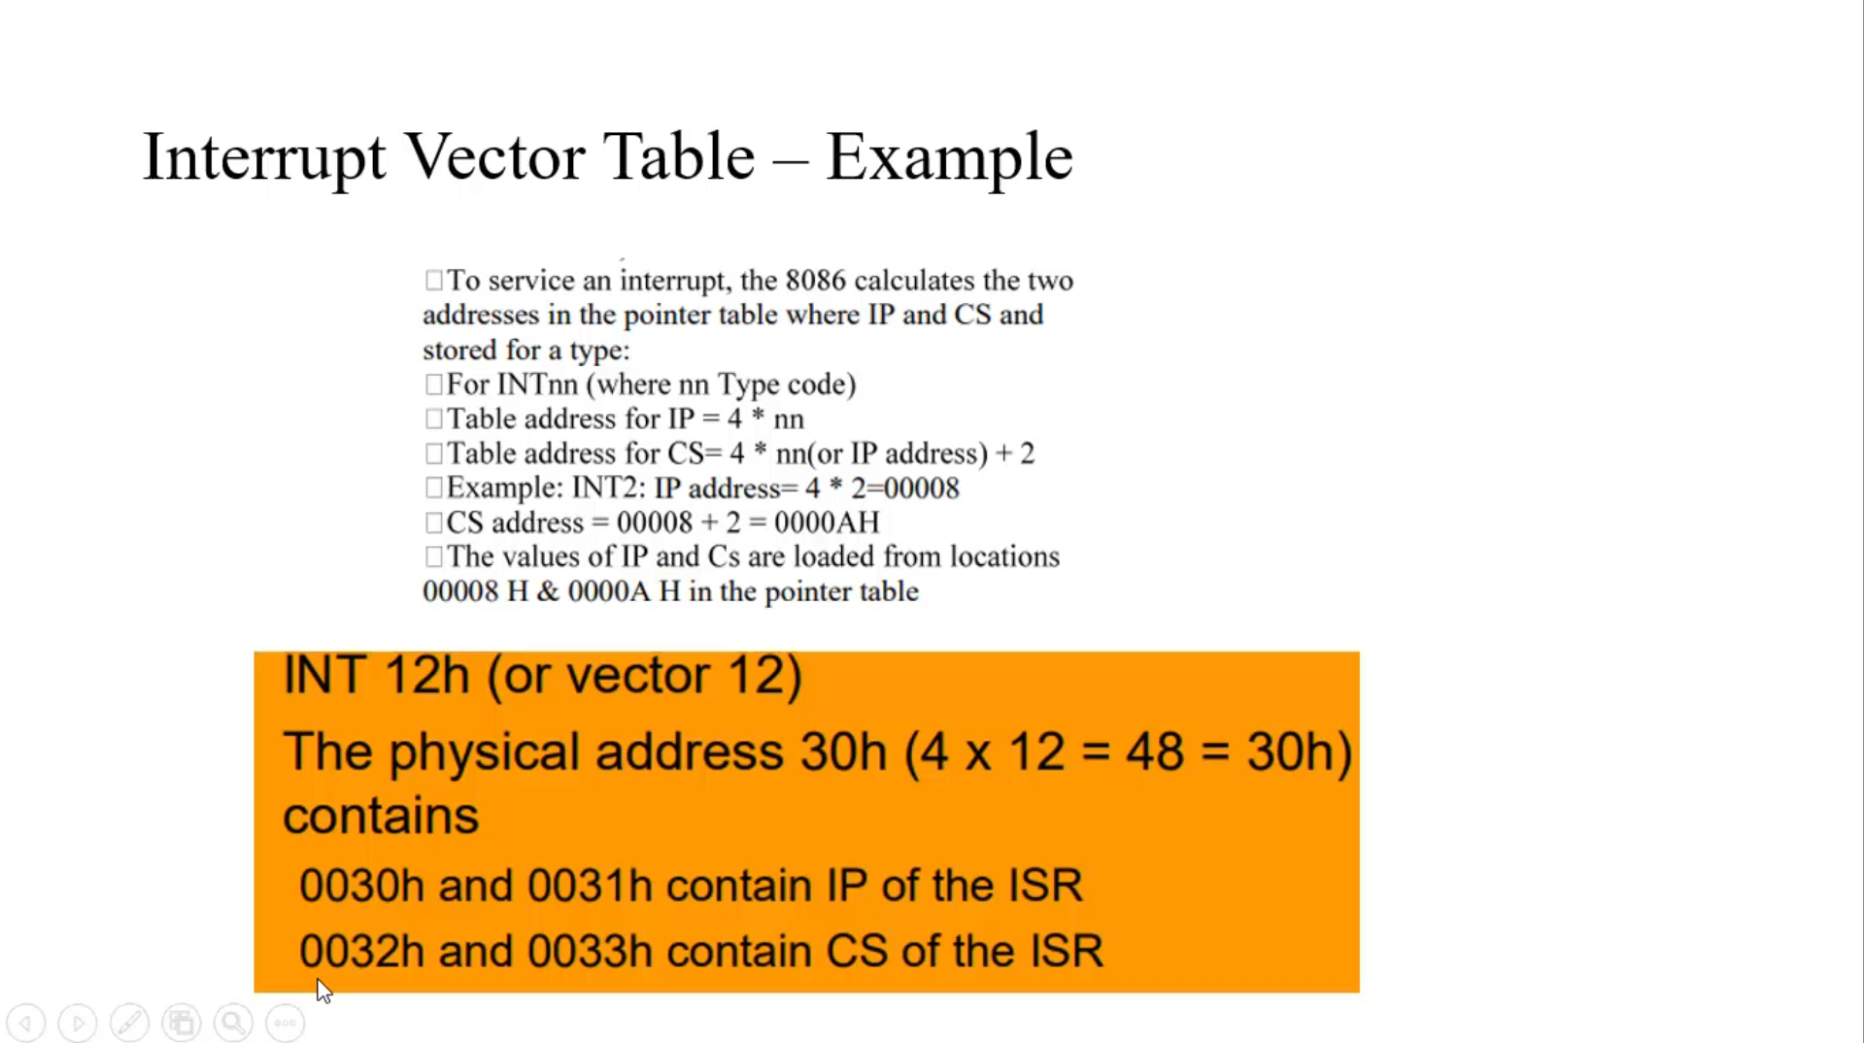

Slide 11
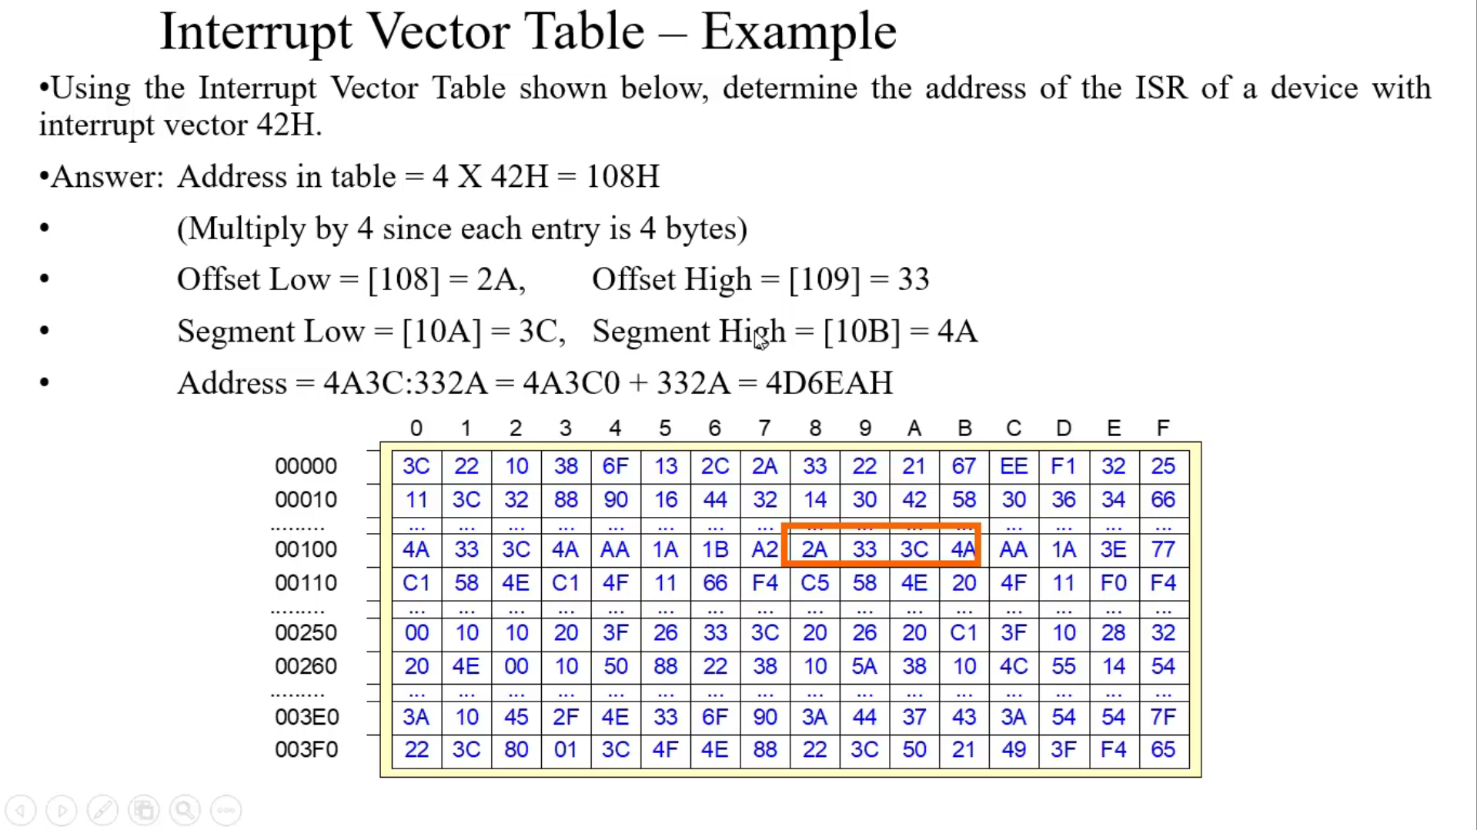

Slide 12
Dedicated Interrupts:
Divide 0
Single Stepping: Processor Checks for Interrupts after execution of each step.
Breakpoint: Checks up to Break Point and then follows the procedure of Breakpoint.
Interrupt on Overflow : It is Conditional Interrupt occurs when Overflow flag set to 1.
NMI: In case of Emergency Conditions.

Slide 13
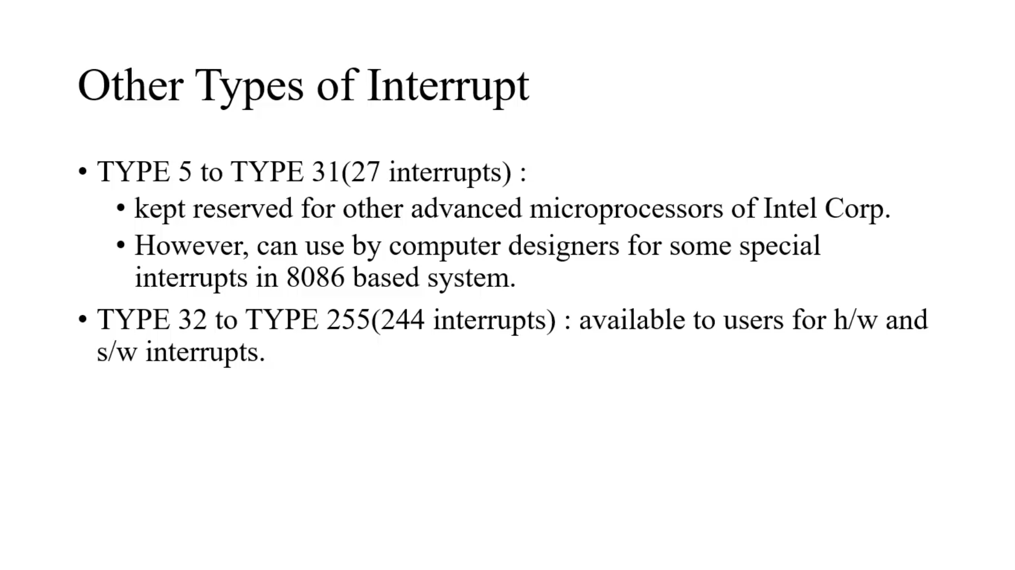

Slide 14
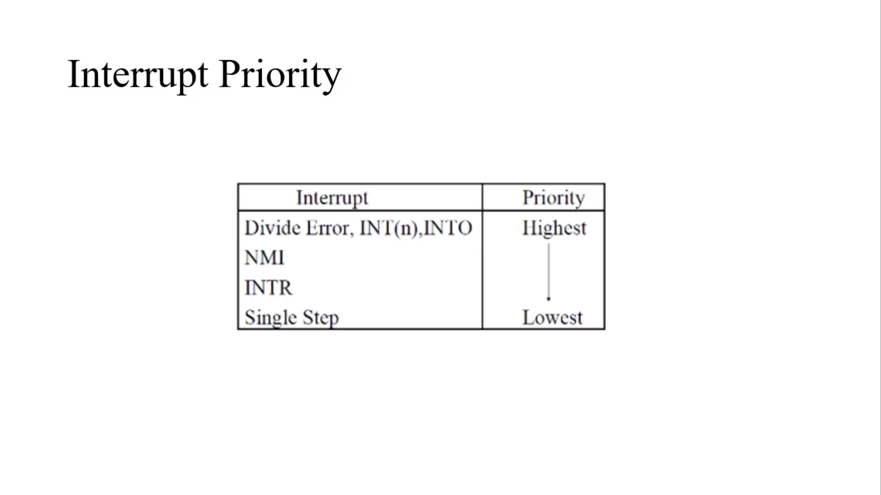

Slide 15
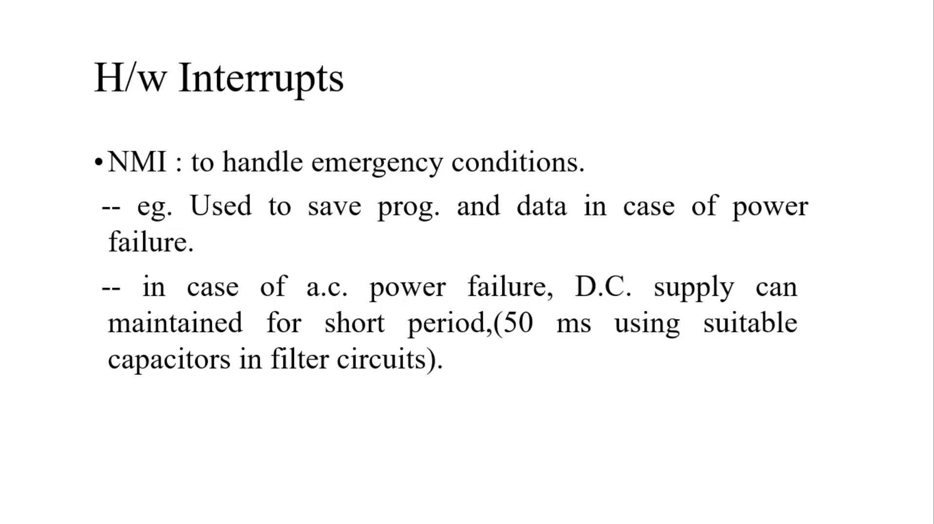
NMI- Non Maskable

Slide 16
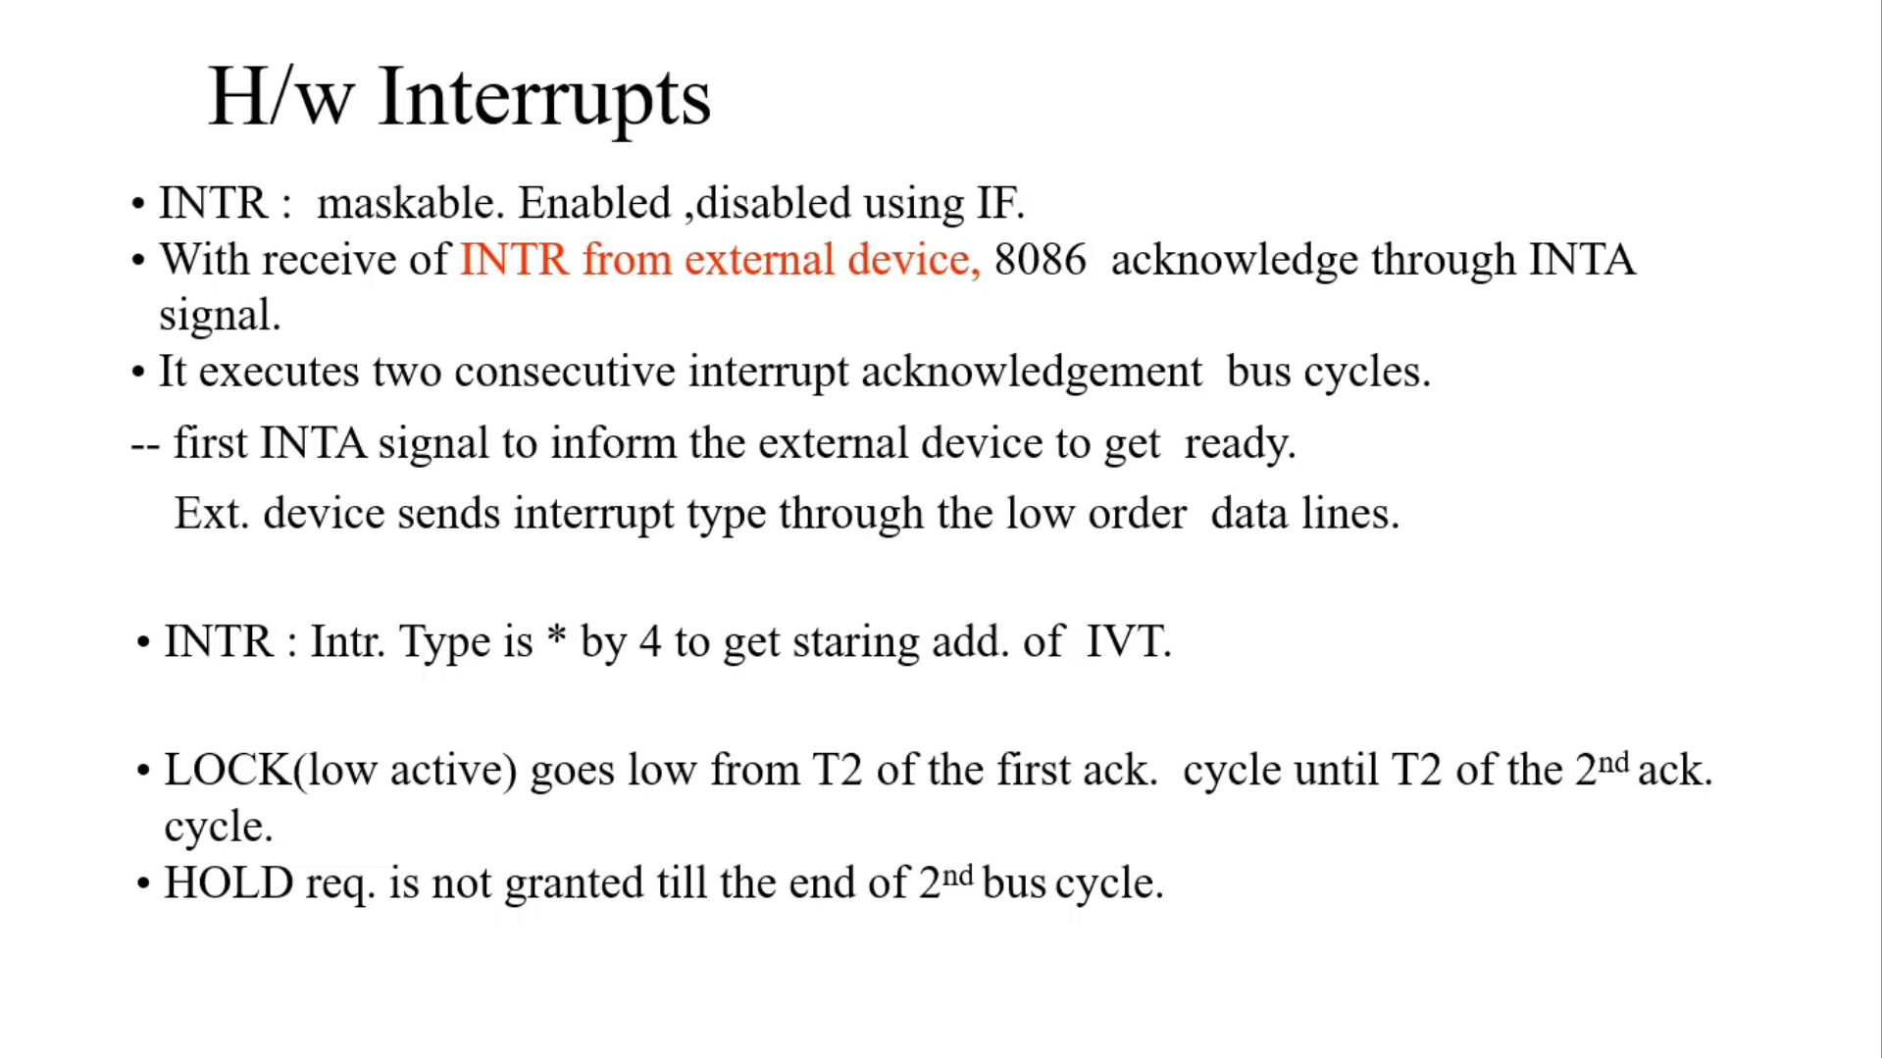

Slide 17
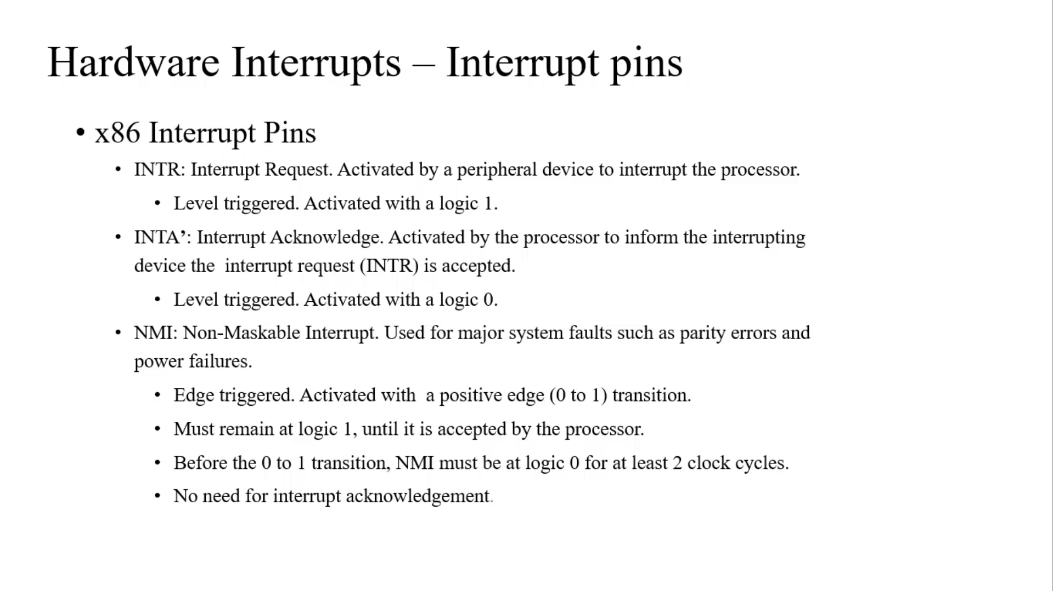

Slide 18
